Slide 1
Interactive Notebooks
Rod Barrett, Randy Crane and Joanne Wall

Slide 2
Our School
Our school is located in the beautiful community of Colliers, in scenic Conception Bay, Newfoundland. We are approximately 45 minutes from the capital, St. John’s. Our school has a student population of approximately 130 students and 15 staff members. Students, teachers, parents and the community at large collaborate to develop a positive, child-centered, learning environment which recognizes the value and uniqueness of each individual in the 21st Century.

Slide 3
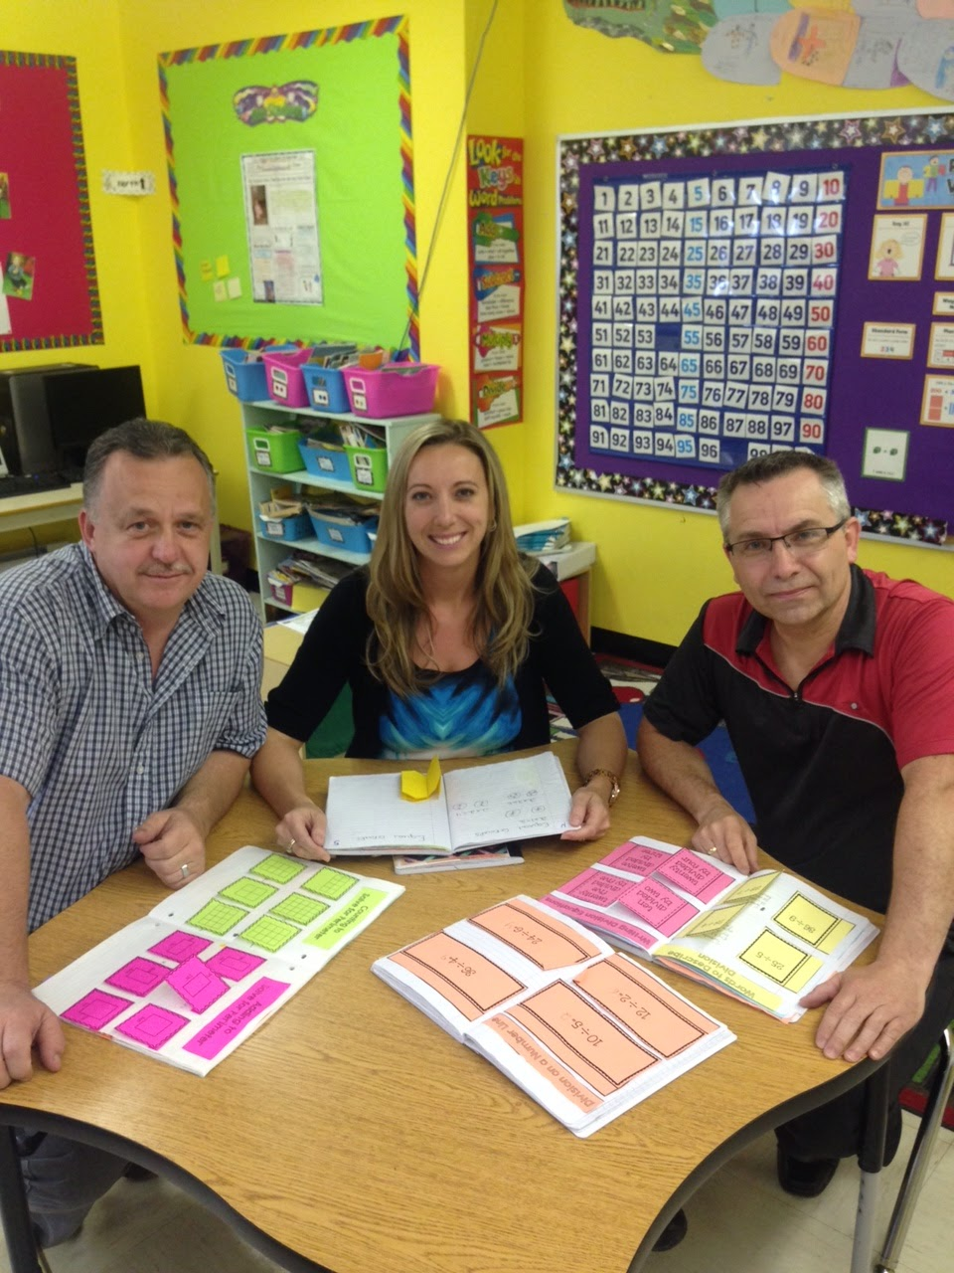
Meet the Teachers
Rod Barrett is a Grade 5 teacher and also teaches science in other grades. This is Rod’s first year with the TIA project.
Randy Crane is a Grade 6 teacher and teaches Math in Grade 4 as well. Randy was involved in another TIA project in 2013-14.
Joanne Wall is a Grade 3 teacher and also provides literacy support. Joanne was also part of a TIA project in 2013-2014.

Slide 4
STEM Background
First TIA STEM Project was in 2013-2014 where team created Math Resource Centers.These MRC’s were so successful that we wanted to further develop certain aspects of them.
Focus for this year came from a common goal to improve and enhance classroom practices. All three teachers were looking at ways that they could engage students more in their classes and wanted to try a new strategy in one area with a long term objective to try it out in other areas
Problem Solving was identified as an area that could be revived. Using Interactive Notebooks would be a new concept for all of us.

Slide 5
Project Research Questions
Question 1:
How will the integration of Interactive Notebooks improve communication of student reasoning?
Question 2:
How teachers feel about the effectiveness of using this tool in their instruction ?

Slide 6
Project Rationale- Why we chose
Why did we choose to use INB’s…Brain Research.
Article about research into how students learn
Brain research shows establishes and confirms that multiple, complex, and concrete experiences are essential for meaningful teaching and learning ( quote)
Teachers need to use different techniques to activate student learning and to meet needs of different learners
Foldables and DI

Slide 7
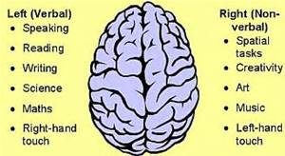
Project Rationale- Continued
The Organization of the INB, by placing notes on one side and student work on the other, can help the brain by making connections between what is experienced(learned) and what the experience (information) means to the learner

Slide 8
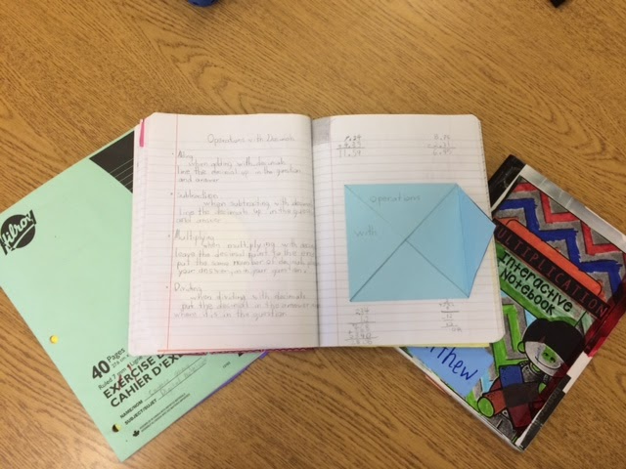
What is an Interactive Notebook
Interactive Notebooks ( INB’s ) are used in classrooms to help students organize and synthesize information given to them in class.
It also serves as a collection of student work.
Teachers can use instructional strategies such as note taking, concept mapping and organization of information to help teach their students.

Slide 9
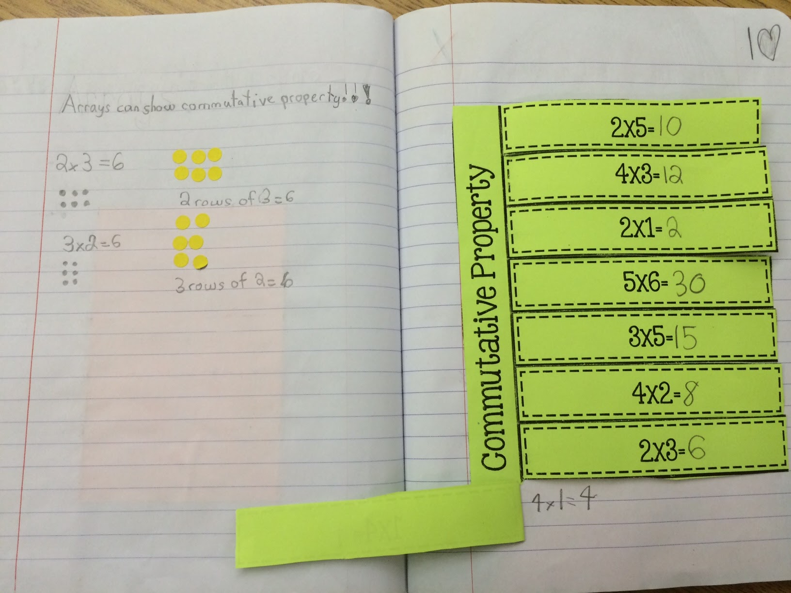
What is an Interactive Notebook
These INB’s can be an important tool to help students remember and retrieve information needed to complete work.
They can also be used to help students process information, study and review for assessments.
It is an organizational tool for both teachers and students.

Slide 10
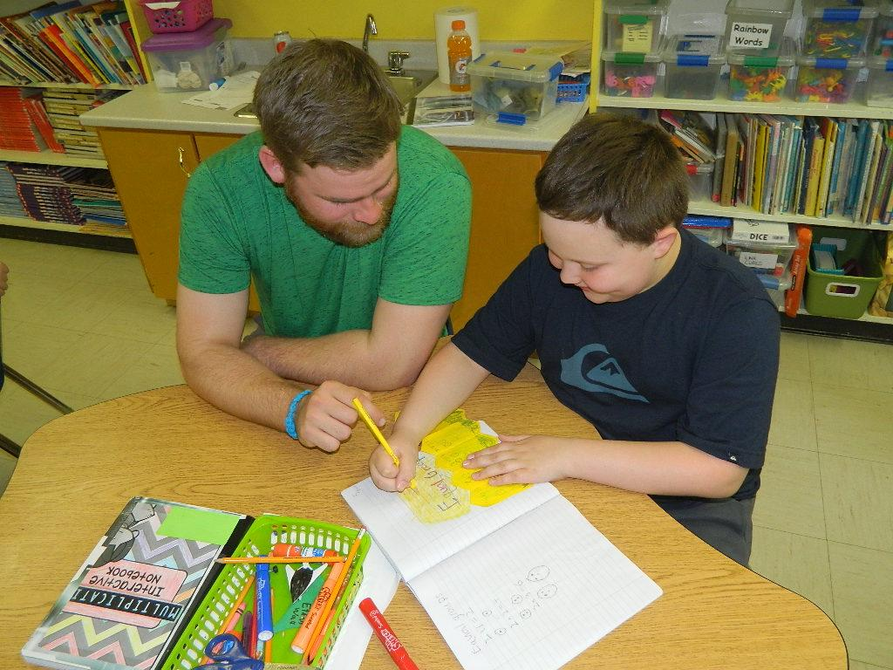
Interactive Notebooks
Teachers must also be cognizant of the learning styles of their students.
These notebooks also encourage teachers to plan lessons that reach a broad spectrum of intelligences.

Slide 11
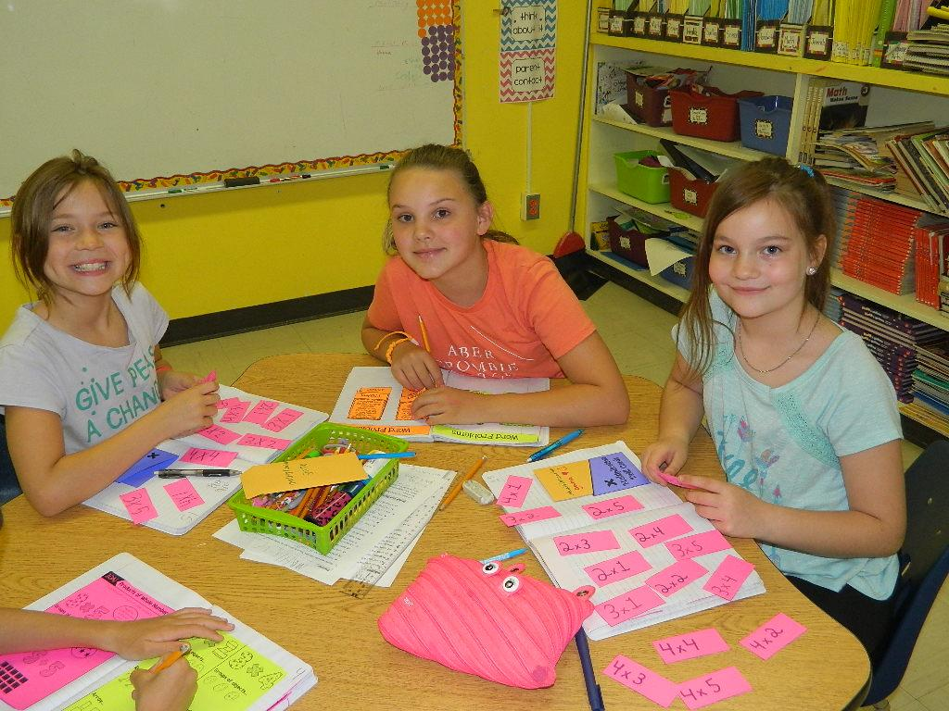
Interactive Notebooks
These notebooks also encourage teachers to plan lessons that reach a broad spectrum of intelligences.
As teachers need to be strategic in planning and choosing activities it also encourages a more focused look at the curriculum being taught.

Slide 12
Planning and Release Days
Curriculum Guides
Choosing Activities
Planning Notes for INB’s
Creating our templates and prototypes
Springboard
Problem Solving templates
Word Walls
Problem Solving Labels
Collegial Chats

Slide 13
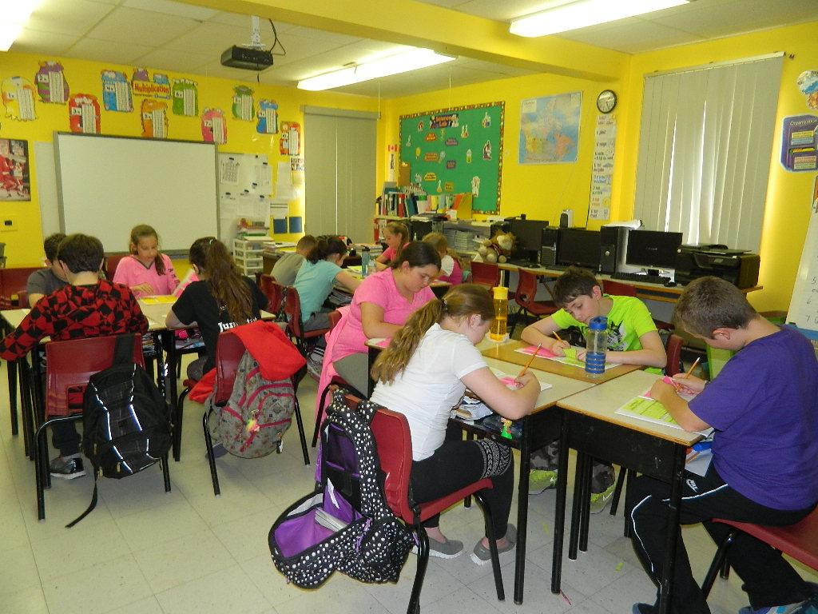
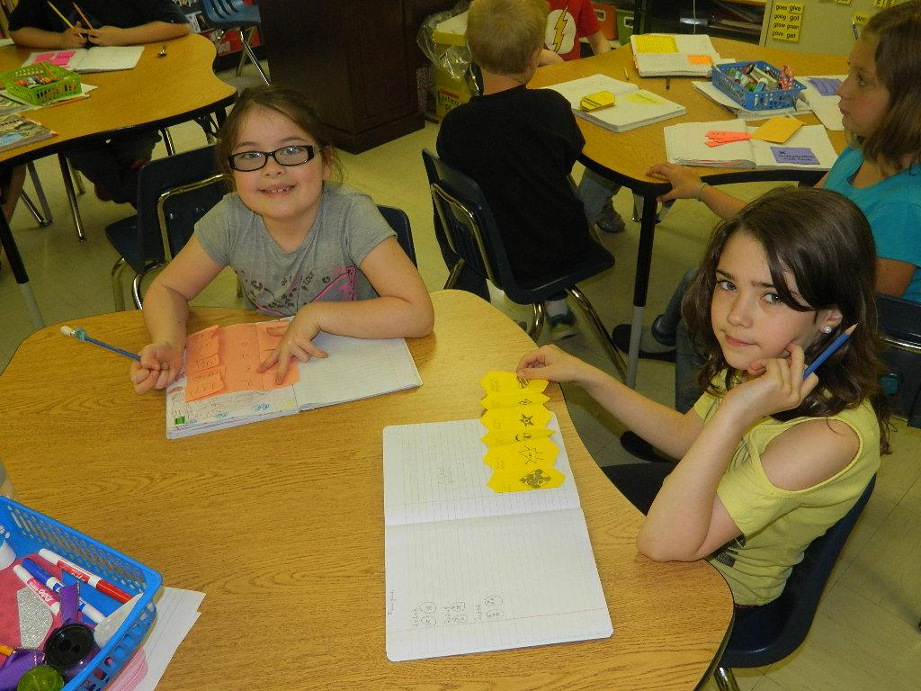
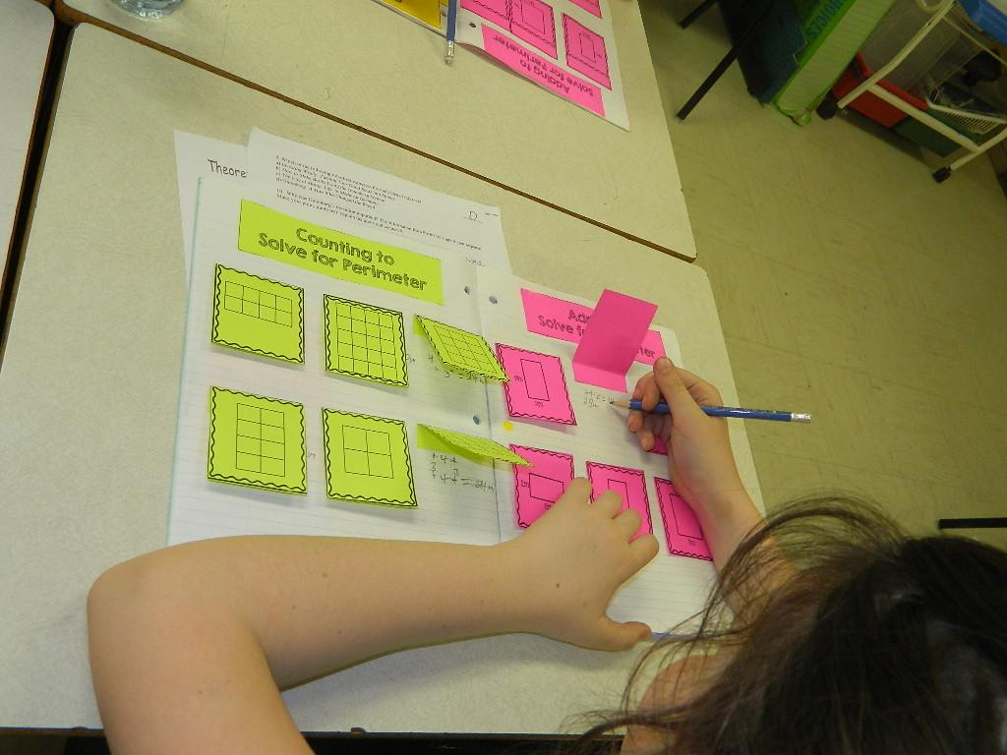
Implementation

Slide 14
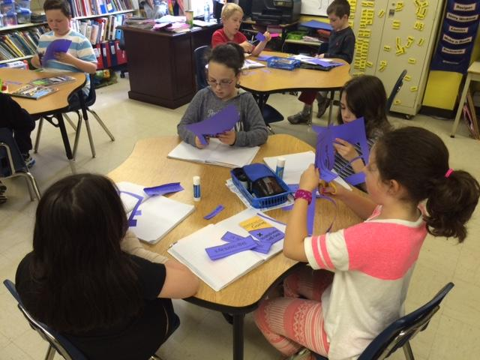
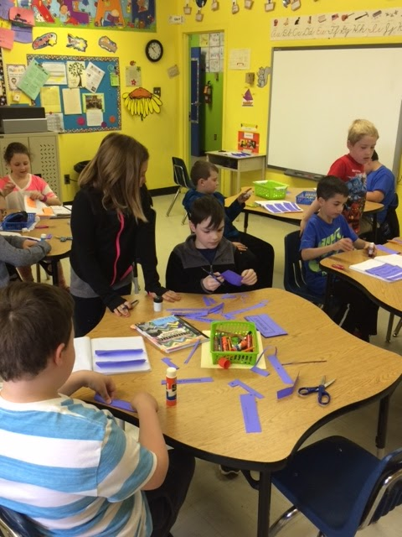
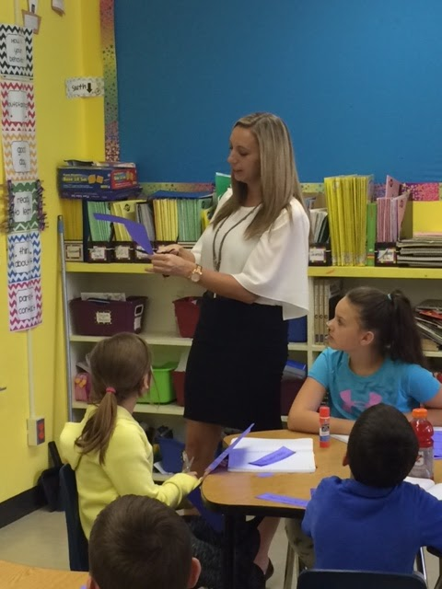
Implementation

Slide 15
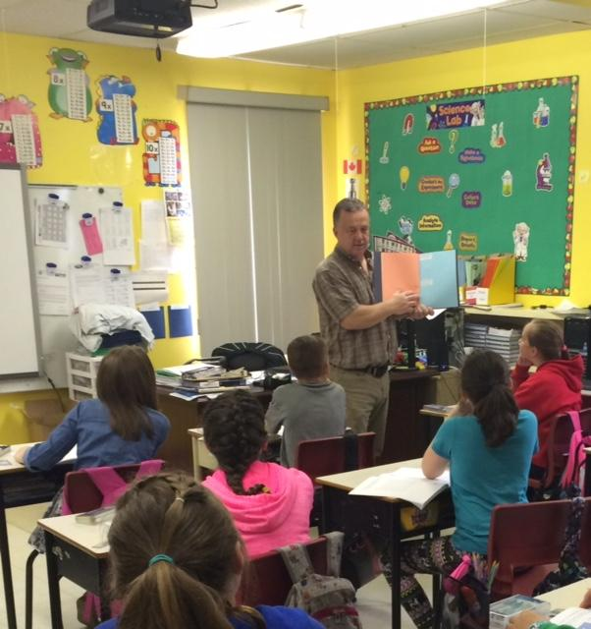
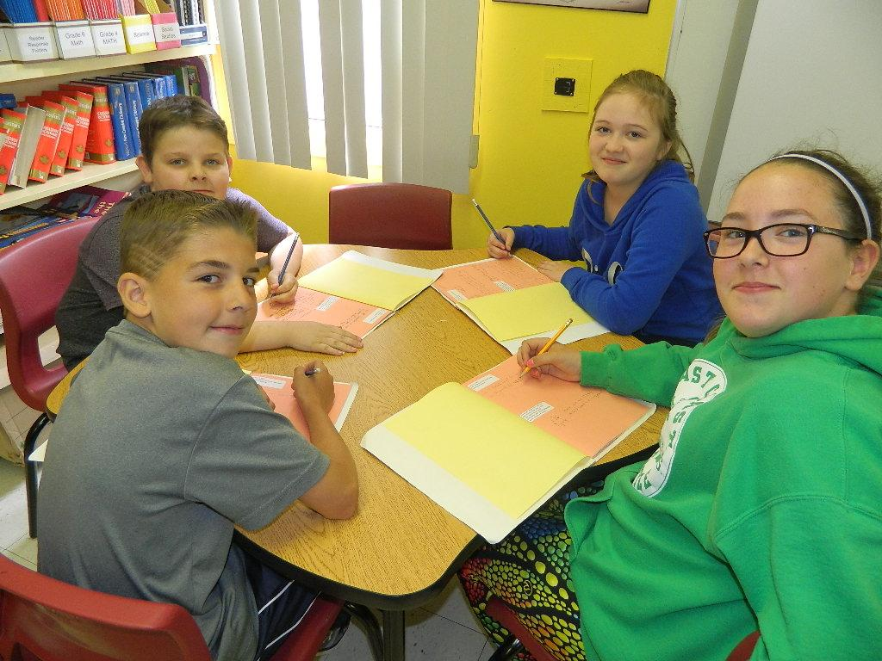
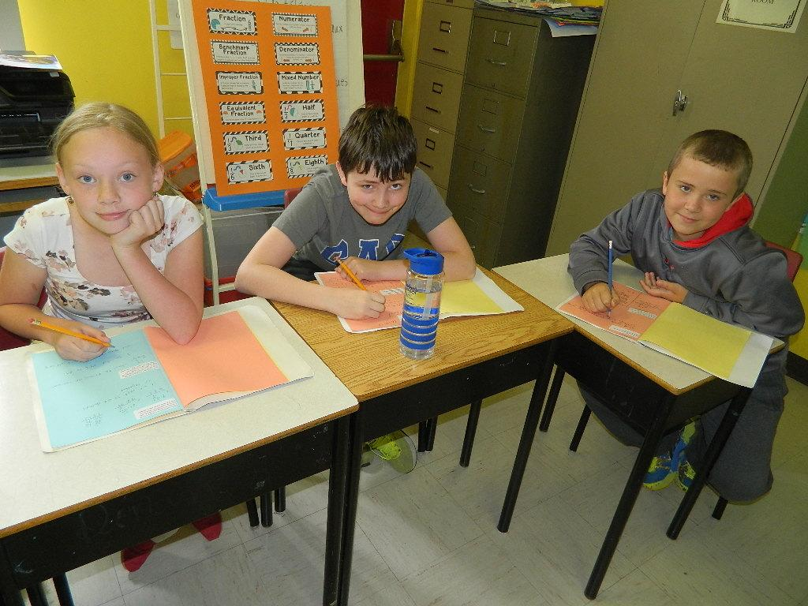
Implementation

Slide 16
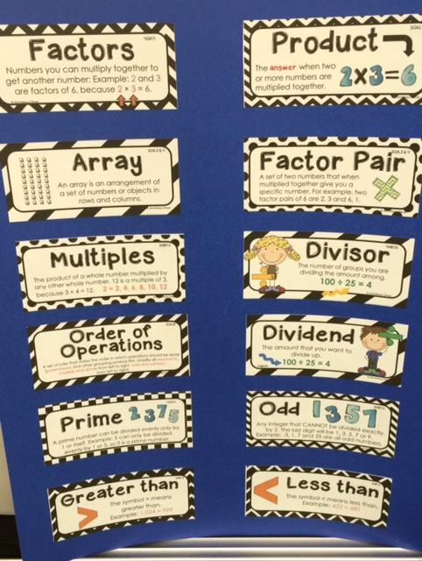
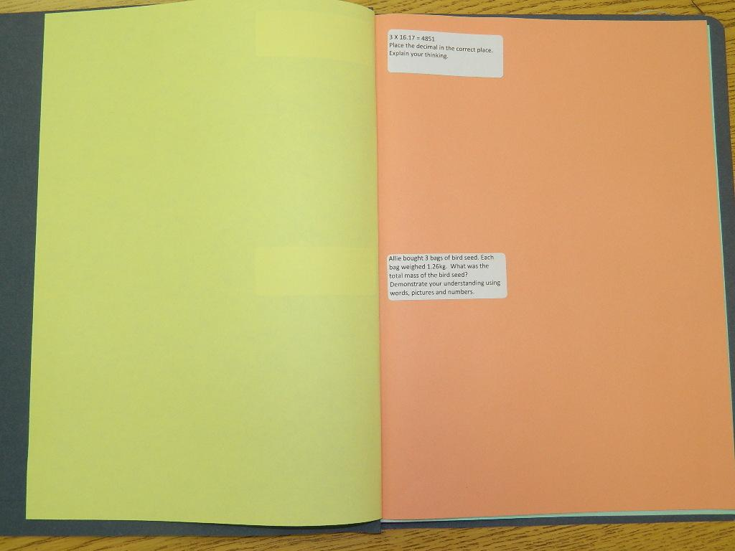
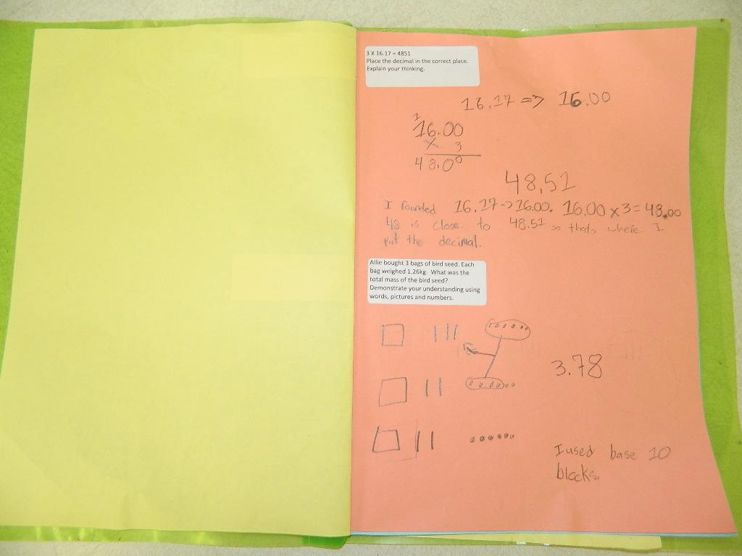
SPRINGBOARD

Slide 17
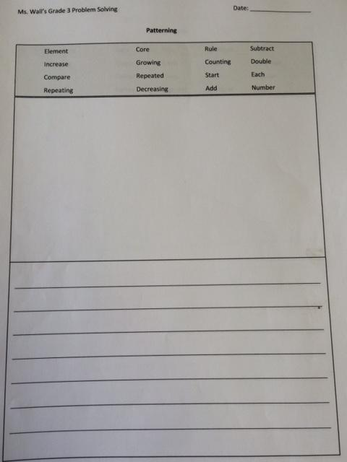
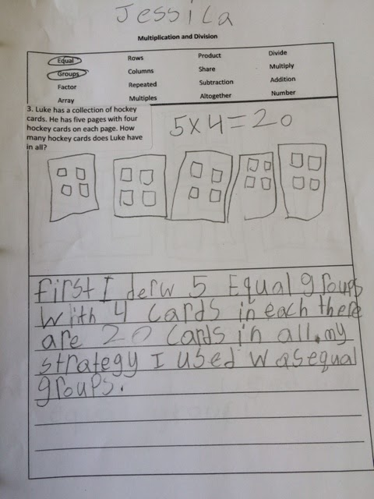
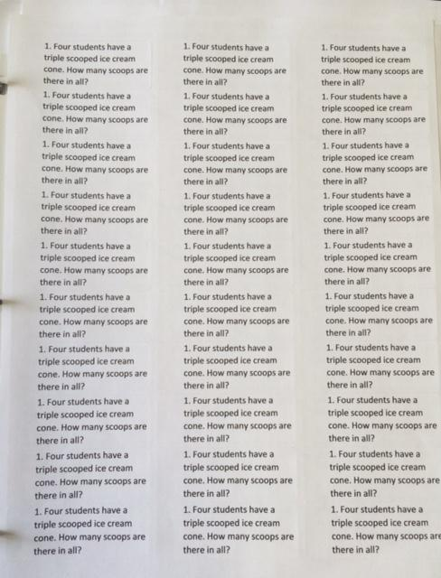
SPRINGBOARD

Slide 18
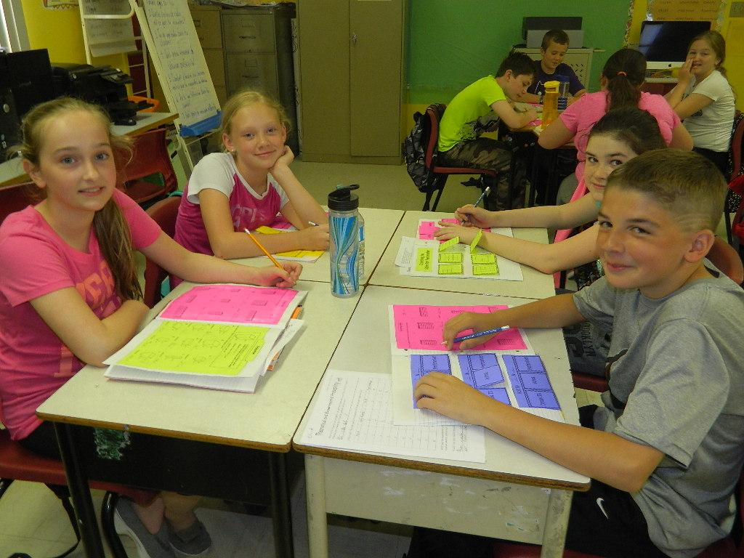
Findings- Students
Student Questionnaire:
“They help you with your math if you are stuck.”
“I like that you can do different activities and use different strategies.”
“It helped me whenever we are doing math because if i don’t know a step I can just go to that page. I want to keep them for next year.”

Slide 19
Findings- Students
Student Questionnaire:
“I liked that if you didn’t know how to do something it would tell you how to and give you an example.”
“I found that the INB work helped me understand the topic better than the textbook or duotang sheets.”
“It was like a fun activity that helps you study and learn but you don’t really realize that you’re studying.”

Slide 20
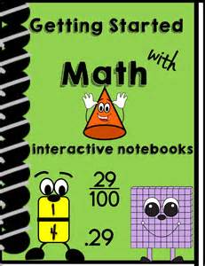
Findings - Teachers
Teacher Notes:
All teachers found there was a considerable improvement in the quality of answers during problem solving
Teachers thought that these were a manageable and easy to use resource
Allowed for student creativity
Students began using these as a reference tool when completing work ( i.e. Dreambox)

Slide 21
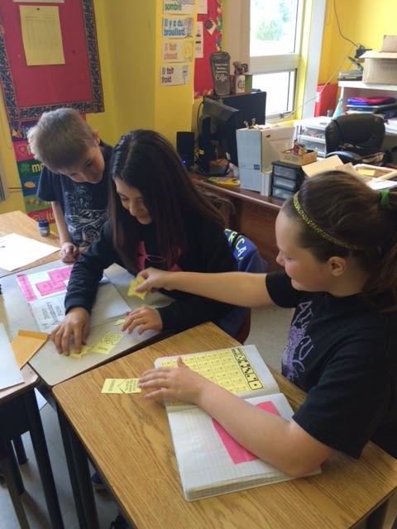
Findings - Teachers
Teacher Notes:
Teachers want to continue with these in other units as well as other subject areas
Believed that these are a great way to keep students organized
More than just a worksheet
Doing an activity became memorable for students- it provided them with a reference.

Slide 22
What is an Interactive Notebook:
“It is something that has a lot of Math and awesome things in it. It is colorful and bright and it teaches kids fun Math.”
“INB’s are notebooks that help us students with math and that we can show that we understand. There are flaps with questions on the front and when you lift the flaps you can see the answer.”
Student Definitions

Slide 23
Future Considerations
After using these INB’s all teachers involved have decided to use these again next year. We want to use them in other units of our Math programs and we also want to try them out in our science and social studies classes.
Many students want to keep these as a reference for their classes next year so we do want to pass these along to the next grade.
When we use these in our classes next year we want to continue to focus on the notes and information we provide students. We want to ensure that the information we provide them with is manageable.

Slide 24
TIA Participation
Once again, here at Immaculate Conception, we had an amazing experience with the TIA project. The opportunities to choose professional development in an area that was of personal interest was great.
While the resources given to us were awesome it was the time given to us in the form of release days that were very beneficial.
We would highly recommend this program to other teachers and are interested in applying again in the future.

Slide 25
Thank You
We wanted to extend our thanks to Karen, Craig and Tom for being such great help to us throughout the time of our project.
To our students who were so enthusiastic about being part of the Research we were doing.
To our colleagues , who were all very helpful and interested in our work. As well as our principal, Mr.Crane, who supported and encouraged us during our participation in this project.

